Slide 1



SPSS intro
For EDUC/PSY 6600

Slide 2
What is “SPSS”
“Statistics Package for the Social Science”
You can use the program to…
entry or read in data
check your data for errors
explore the data
run statistical analysis
create tables & graphs
THREE main windows
Data Editor (data view & variable view)
where you can look at the actual data values
Syntax
where you type or paste commands telling what the computer to do
Output
where the program spits out ‘stuff’ you need to interpret

Slide 3
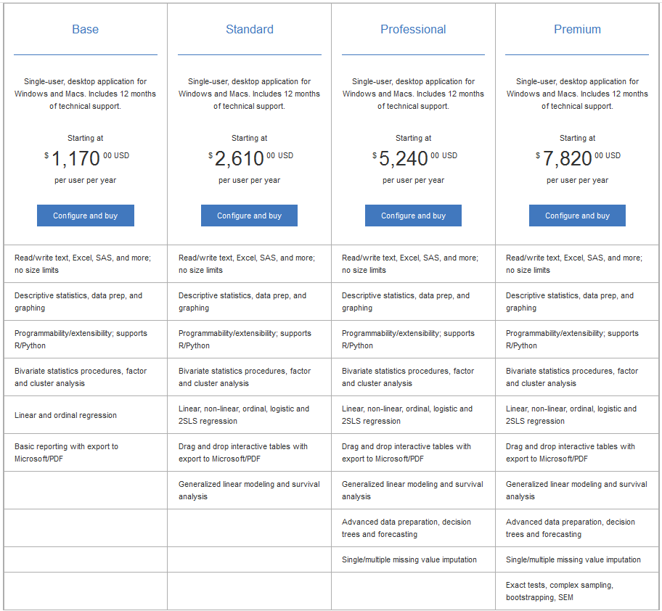
How to get spss
Most every computer lab on USU campus has SPSS installed
If you are a paying student at USU, you can run SPSS remotely on any other computer for free through “apps.usu.edu” (see Canvas for directions to use Citrix)
You can pay big bucks to have your own license $$$
‘Gard Pack 23.0’ Base = $41/6 months, Premium = $99/year (summer 2016)

Slide 4
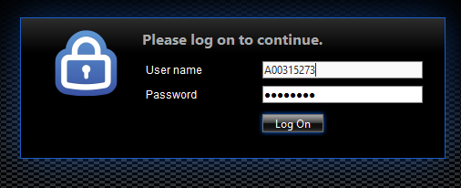
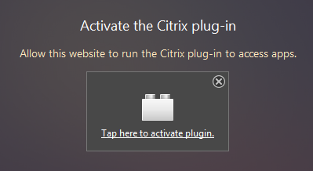
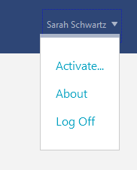
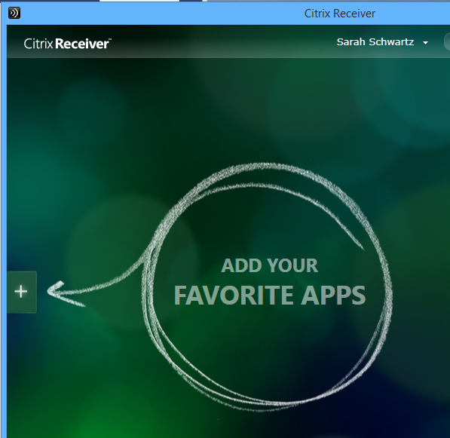
SPSS via citrix
Go to “apps.usu.edu”
Login w/ you’re a-number & strong password
Activate the Citrix plug-in (if asked…“allow & remember”
First time you will need to click the down arrow by your name {upper-right corner}, click: Open “receiverconfig.cr”, click: “Add”, you may have to put your password in again
In the new ‘green’ window, add your apps to the window by clicking on the “+”

Slide 5
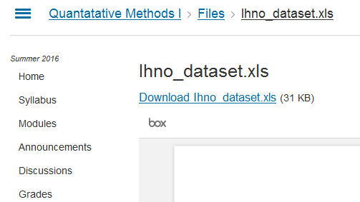
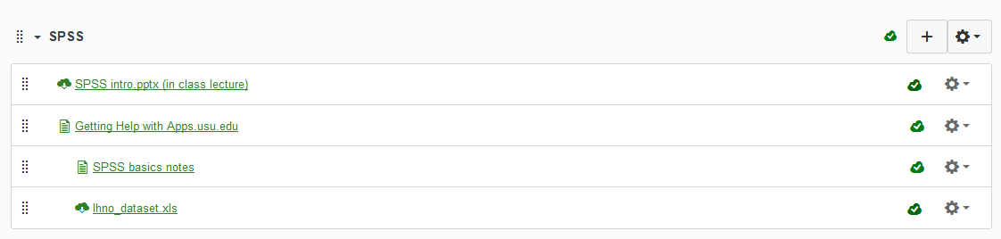
How to Open the Ihno (“Eee-know”) dataset
Download the dataset to the computer you will be working on by going to our CANVAS page, under the Module for SPSS click on the Ihno_dataset.xls . Then you will need to click on the writing in blue that says “Download Ihno_dataset.xls”. Save the file somewhere you will remember and can find in the next step.

Slide 6
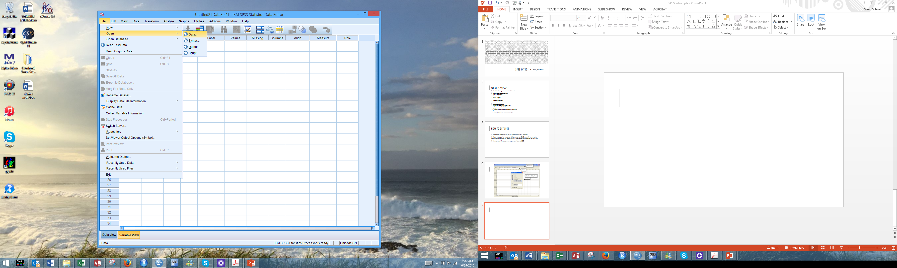
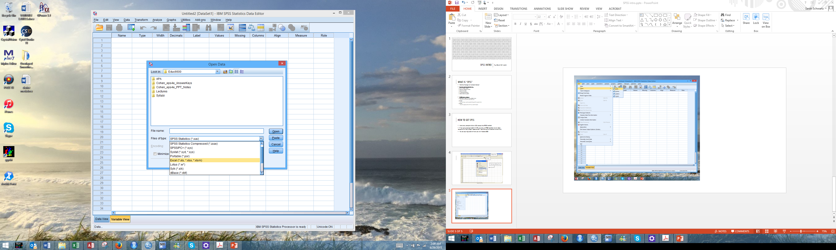
Start the SPSS program and open the file you just saved by clicking the following: File > Open > Data. Make sure to change the drop down menu for “Files of type” or you will not see the name of the file you just saved. When you have used your mouse to highlight the file name, click “Open”.

Slide 7
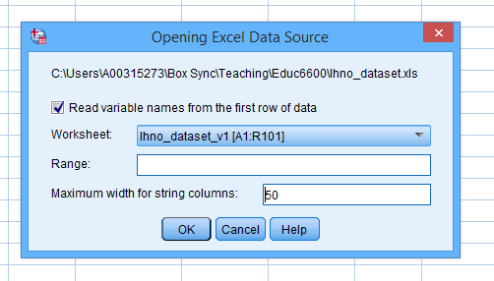
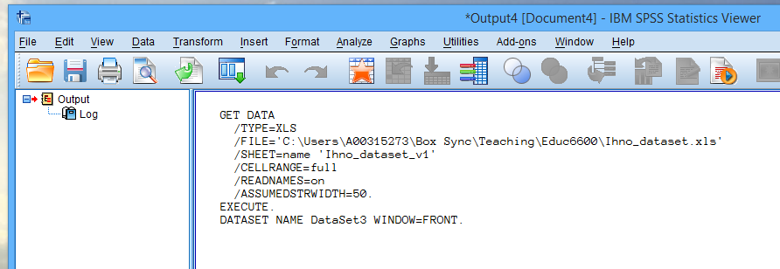
An OUTPUT window:
3. The “opening Excel Data Source” window will then pop up. This is where you can change the ‘sheet’ if there are multiple sheets in the workbook (ignore for now since our file only has one sheet in it). You will probably want to change the “Maximum width for string column” to a smaller number, like 50. Click “OK”.
Note: when you click “OK” SPSS automatically types out the code commands that tell the computer to do all the things we just clicked on. This code appears in the OUTPUT window. The data will now appear in the DATA window.

Slide 8
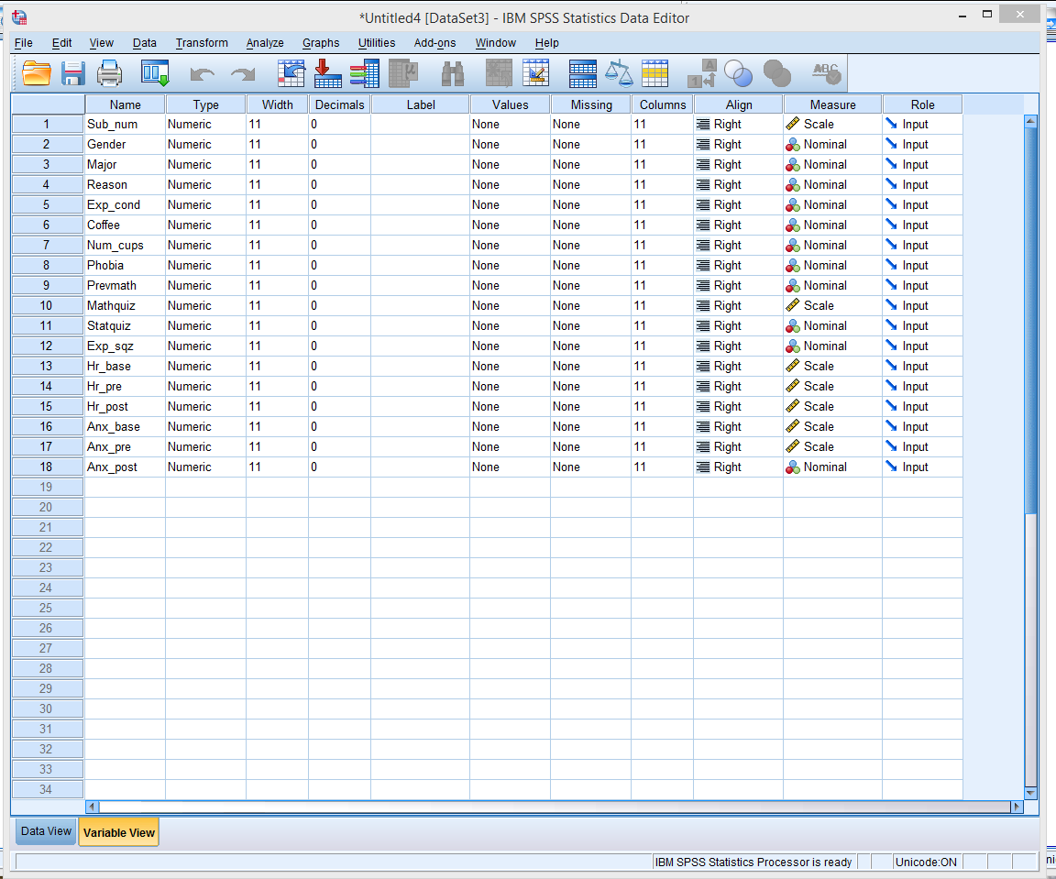
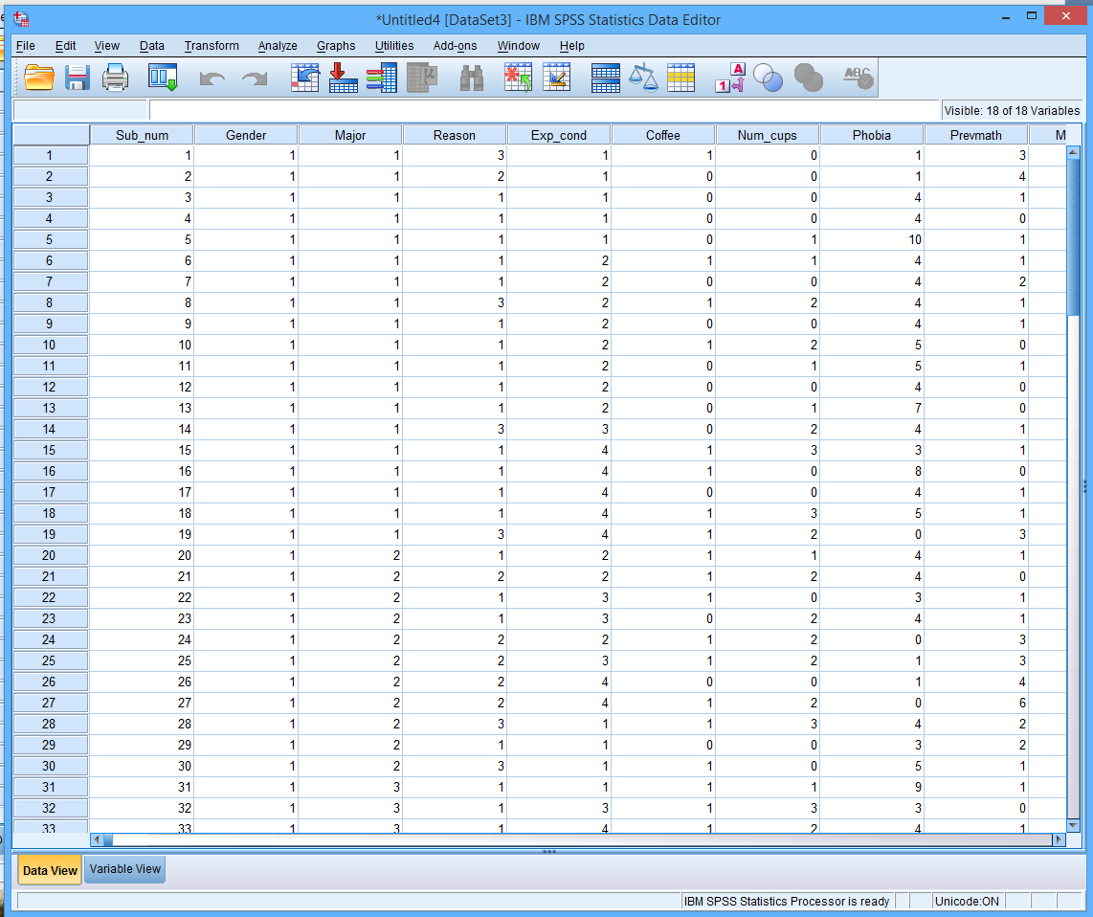
Data editor: TWO VIEWS

Slide 9
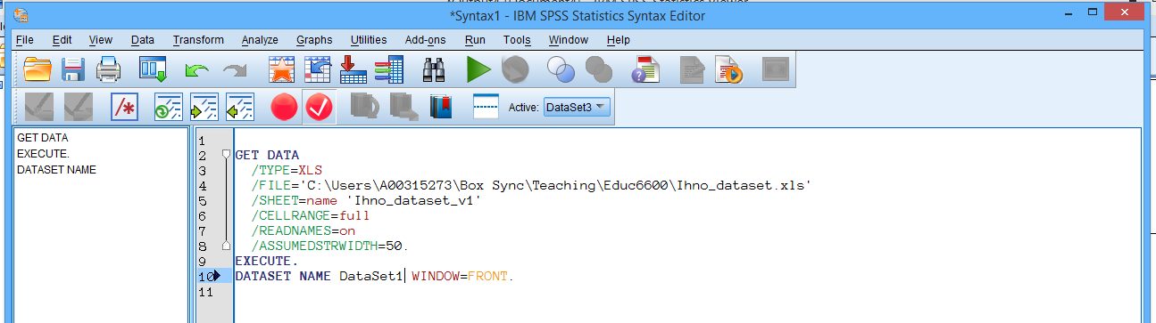
Syntax file
The third window type is for “SYNTAX”.
To start a new project (from any SPSS window), click: File > New > Syntax
There are three ways to get commands in this window:
Type them by hand, from scratch (the auto-complete is handy!)
Copy-paste from the output window, a website, or class handout
Press the ‘paste’ button instead of the ‘OK’ button on most point-and-click SPSS menus
Notice the nice color coding ☺

Slide 10
A case for using syntax files
It creates a RECORD of what files you have used and what you have done, saving you time trying to remember what you did…especially when the journal article you submitted comes back for revisions 3 months later
You can copy-paste bits and pieces of code to adjust and RE-USE, saving you time with similar steps on the current project and future
More advanced analyses have VERY complicated drop-down menus that are confusion, even if you know what you want to do. Syntax is usually more CLEAR.
Some things can ONLY be done using syntax…the analysis or option is NOT available in the drop down menus
MAKE LOTS OF NOTES!!!
All code has at least one collaborator…future you!
(use a * at the start of the line and a period at the end)

